Slide 1
SC2001
Example Class 2
Team 2
YOUR LOGO HERE
Cheong Jia Rong (U2121138J)
Goel Armaan (U2123642H)
Chiam Da Jie (U2121233G)

Slide 2
CONTENTS
Analyze Time Complexity of Dijkstra’s algorithm with an adjacency matrix and array for the priority queue
Analyze Time Complexity of Dijkstra’s algorithm with an array of adjacency list and a minimizing heap for the priority queue
Compare the two implementations
Chiam Da Jie

Slide 3
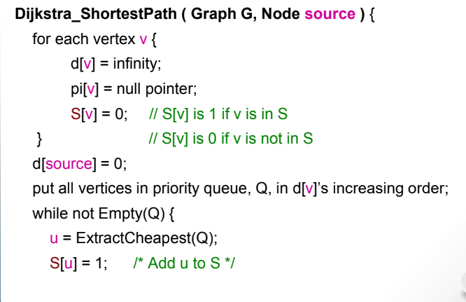
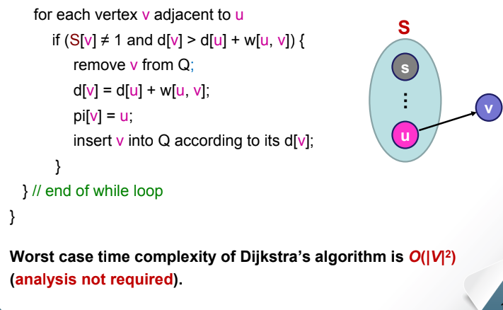
Dijkstra’s Algorithm
This is an algorithm to find the shortest paths from a single
source vertex to all other vertices in a weighted, directed or undirected graph. All weights must be nonnegative.
Chiam Da Jie
Notes:
https://www.baeldung.com/cs/dijkstra-time-complexity
https://www.scaler.com/topics/data-structures/dijkstra-algorithm/

Slide 4
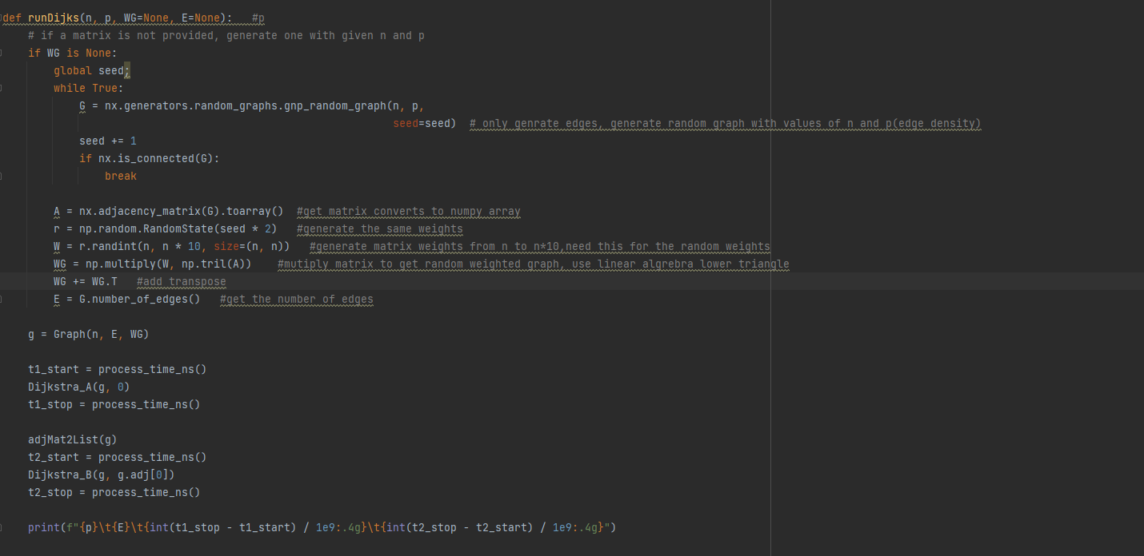
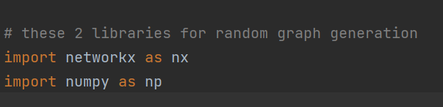
adjacency matrix and an array for the priority queue.
Chiam Da Jie
Notes:
Explain briefly for the generating of matrix , import network x.

Slide 5
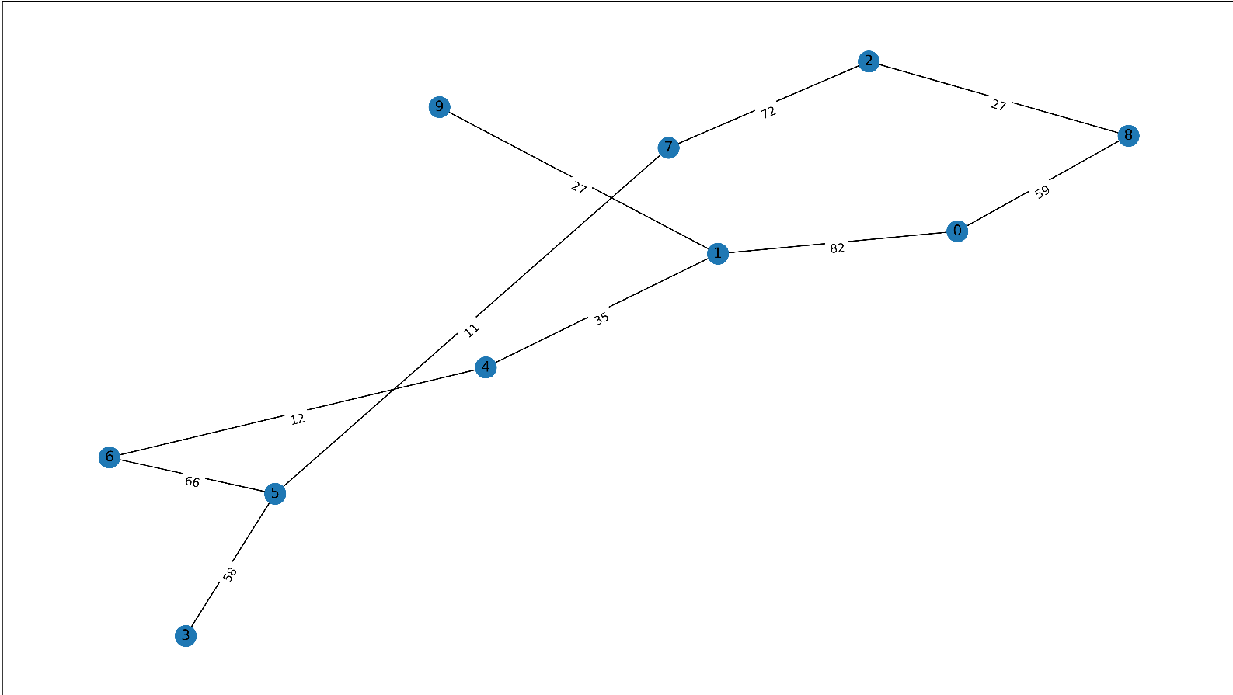
(a) adjacency matrix and an array for the priority queue.
n = 10, p = 0.1
Chiam Da Jie

Slide 6
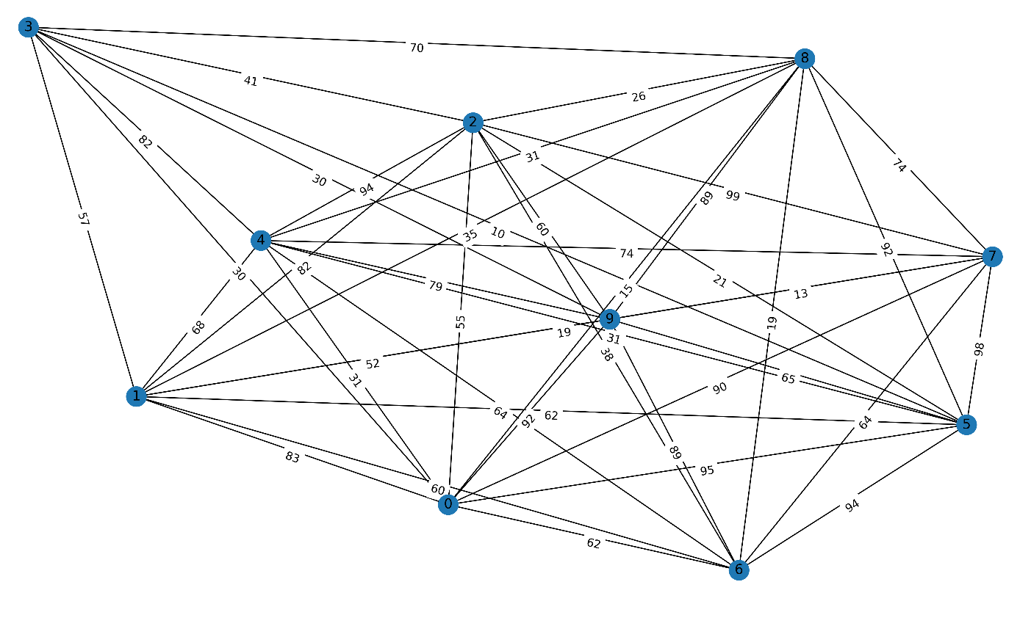
(a) adjacency matrix and an array for the priority queue.
n = 10, p = 0.9
Chiam Da Jie

Slide 7
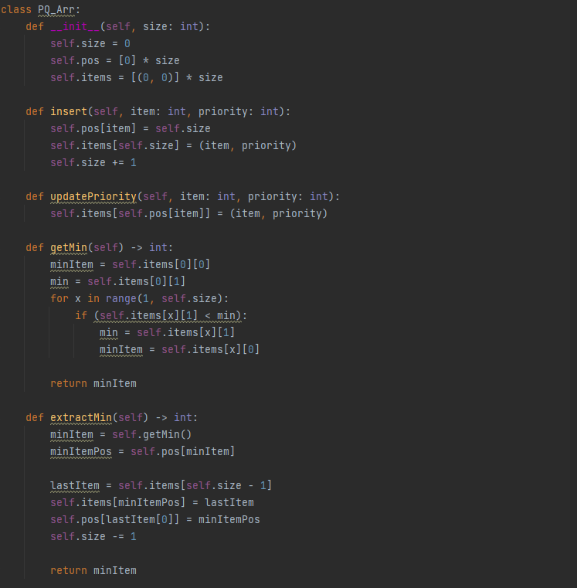
adjacency matrix and an array for the priority queue.
O(|v|)
O(|v|)
Chiam Da Jie

Slide 8
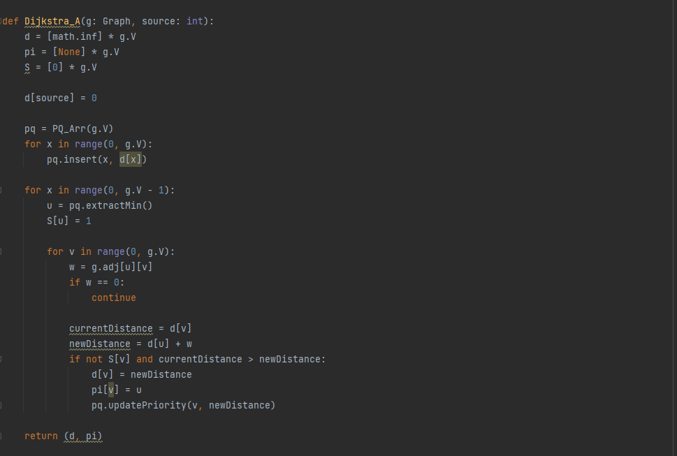
adjacency matrix and an array for the priority queue.
Initializing: O(|V|)
Extracting Min: O(|V|）* V iterations = O(|V * V|)
Checking the neighbours: O(1)
Looping through the neighbours: V*V times
O(|V * V|)
Distance checking: O(|E|)
Overall Time Complexity: O(|V * V|)
Chiam Da Jie
Notes:
Extracting min
Loop through the neighbours(inner loop)
Distance checking(update priority)

Slide 9
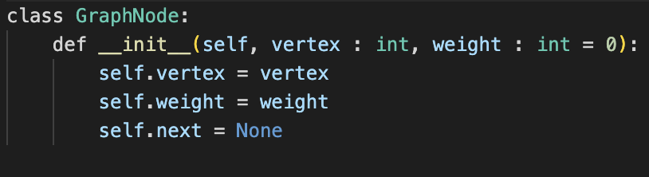
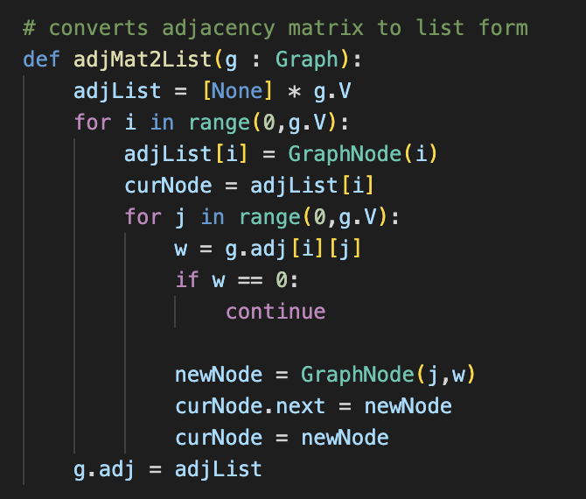
(b) adjacency list and minimizing heap for the priority queue.
Jia Rong
Notes:
For part B, we are supposed to implement dijkstra algorithm using graph given in an adjacency list and a minimizing heap for the priority queue.
Previously DaJie has briefly mentioned how we generate the graphs. The graphs generated are in the form of matrix, so to convert it to an adjacency list, this is the helper function which takes in the graph in the form of matrix as the parameter. The first for loop, we initialise the first element to be a graphnode for each vertices, then we check for the node if it has an weighted edge to other vertices using a nested for loop, if there is we will include it in list.

Slide 10
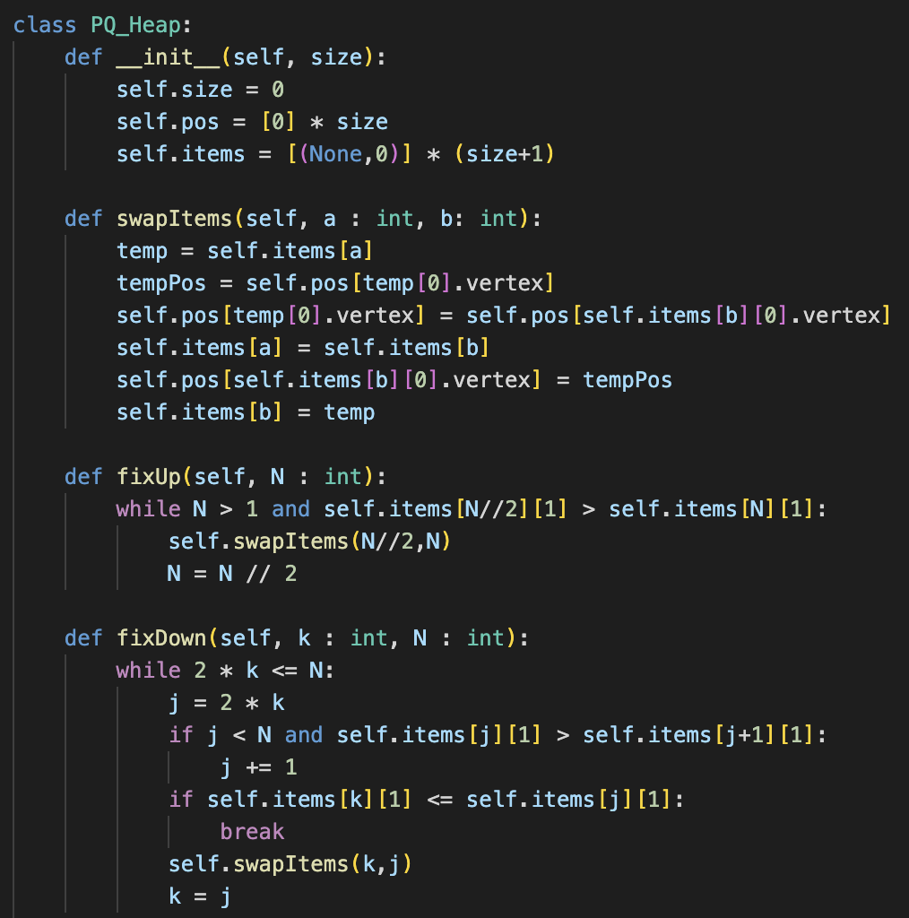
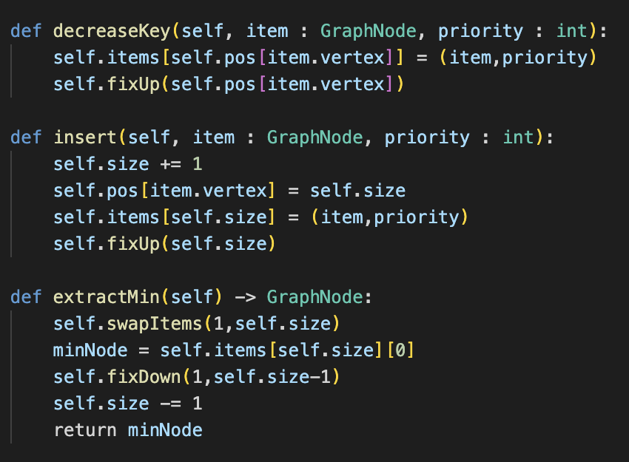
(b) adjacency list and minimizing heap for the priority queue.
Jia Rong
Notes:
To create the minimizing heap, we created a class for the heap and the respective methods. Since its a minimizing heap, the smallest element should be at the root. I will be going through the methods in details in the next slide.

Slide 11
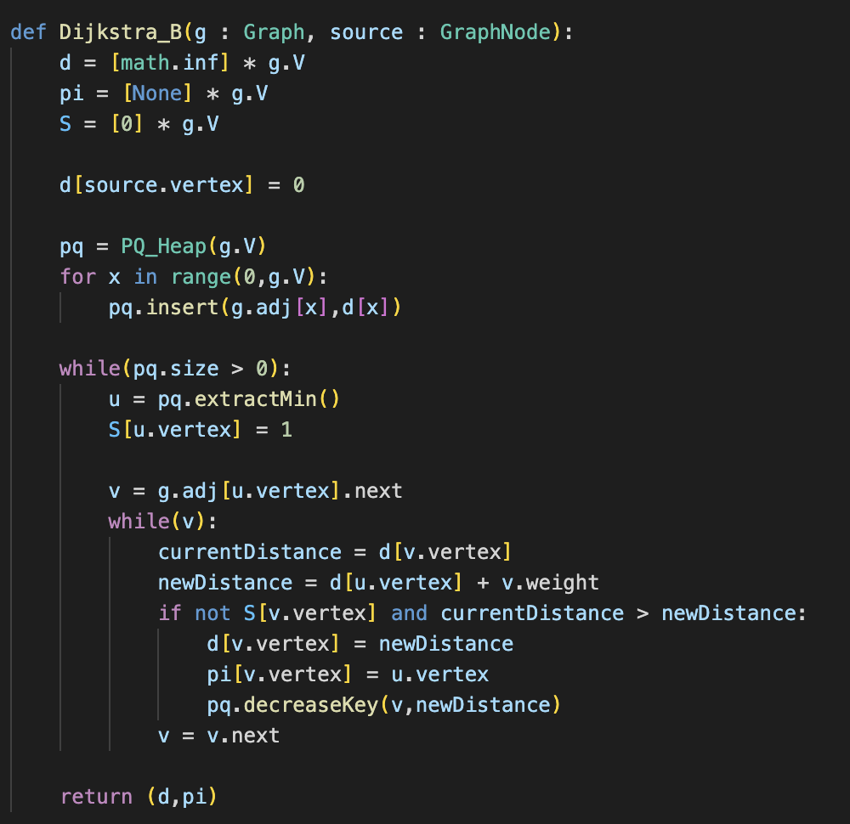
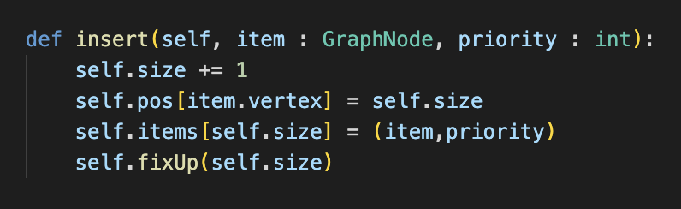
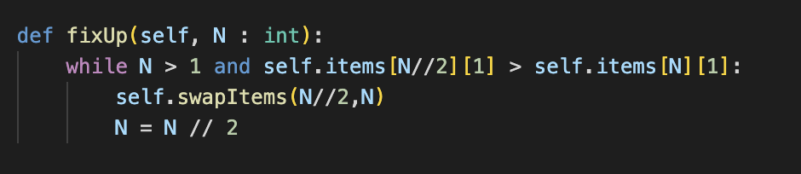
(b) Time Complexity of B
Average time complexity : O(lg|V|)
Average time complexity : O(1)
Jia Rong
Notes:
This is the implementation of our dijkstra algorithm using minimizing heap and adjacency list. To analyse the time complexity, we first
have to understand how the algorithm work. Firstly we initialise the distance array to be 0 parent array as none and solution array to be 0 for all vertices. Next we pick the source node and set the distance to be 0. Next we initialize pq to be a priority queue using minimizing heap and insert the vertices into the priority queue. Take a look at our insert function, it takes in a graphnode and priority of the node item. Noticed that we have two arrays, one to store the position of the vertex and another to store the corresponding set of item and priority in an item array. There is also a fixup function to heapify the priority queue when we insert. FixUp function will ensure that the parent node is always lesser than its child nodes, and since N undergoes floor division of 2 each iteration, we can have an average time complexity of O(lg|V|) . however in our case, the while loop in the fixup function will not run because the distance are all set to infinity at the start soits false, our insert function average time complexity is O(1) constant time, and since there are V number of vertices in the graph and our insert function runs for V times, the average time complexity is actually O(V) in our case.

Slide 12
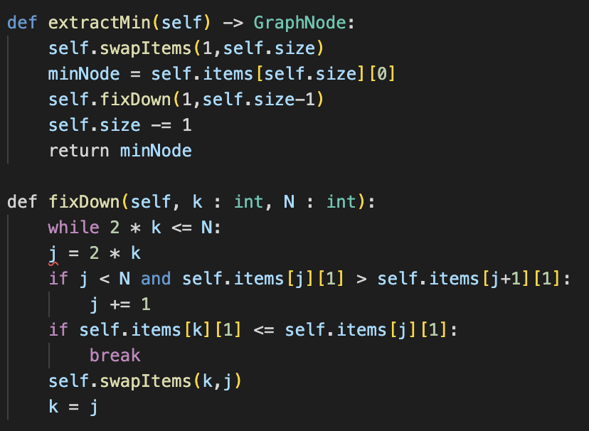
(b) Time Complexity of B
Average time complexity: O(lg|V|)
Jia Rong
Notes:
Now moving on to the next part of our code, after inserting all the vertices in the priority queue, we will extract the minimum node which in this case is the source vertex after the first iteration, in our extractmin function, we will return the original root of the heap after we swap the root of the heap with the last element of the heap and call fix down function to fix the heap. Fixdown function has an average time complexity of lg V. in this while loop, extractmin function will run a total of V times thus the overal complexity for extractmin is VlgV.

Slide 13
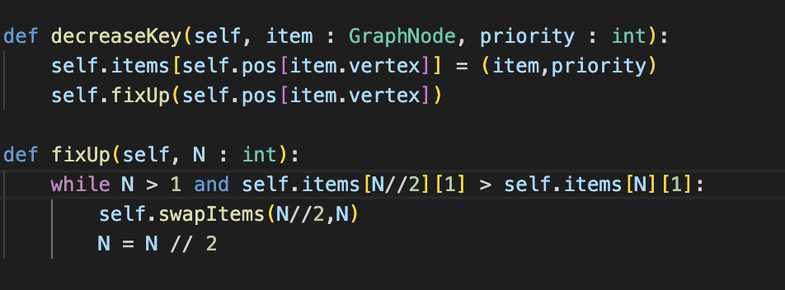
(b) Time Complexity of B
Average Time Complexity: O(lg|V|)
Jia Rong
Notes:
Moving on, after the extract min, we set the min node in the solution set to be 1 as we include the node in our solution. Next we check if the vertex has any edges, if there is we will get the distance from the adjacent vertex to the source node and also the new distance by summing the distance from the source node to the parent node and from parent node to the adjacent vertex. We will update the distance array with the shorter distance and the parent array accordingly. After the new distance is updated we have to update our priority queue which is the decrease key function. Our decrease key function will update the priority of the node with the new shorter distance. After updating the priority queue, we have to fix the heap, and we will call the fix up function since the new distance is shorter and should be placed nearer to the root instead. Fix up will ensure that all the parent node is smaller of equal than its child nodes and this will result in a averager time complexity of lgV. Since decreasekey is called E times, which is the number of edges, our overall time complexity for decreasekey will be ElgV.

Slide 14
(b) Time Complexity of B
Initializing of heap:
O(|V|)
extractMin:
O(|V|lg|V|)
decreaseKey:
O(|E|lg|V|)
Overall time complexity :
O((|V|+|E|)lg|V|)
Jia Rong
Notes:
So this will be the overall time complexity of our dijkstra algorithm, which is V+E lgV. Now i will pass the time to Goel to share about the comparisons.

Slide 15
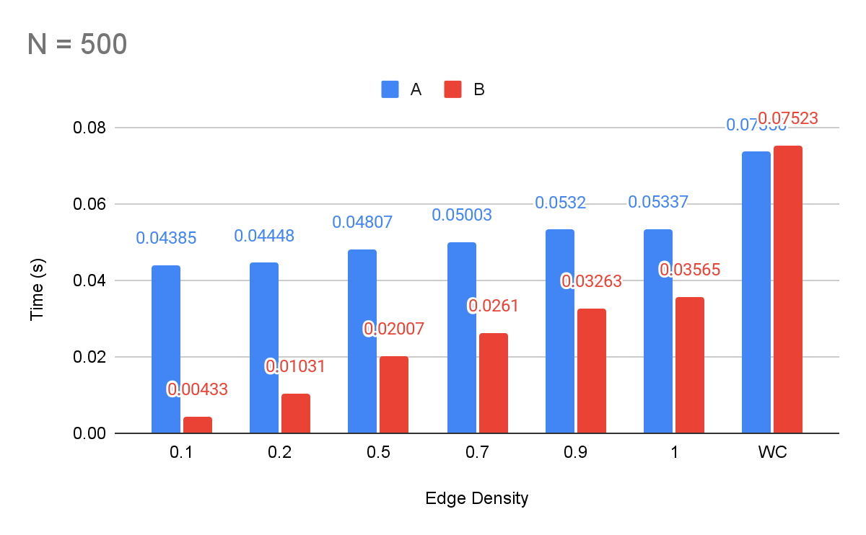
(c) Comparing the two implementations
Goel Armaan

Slide 16
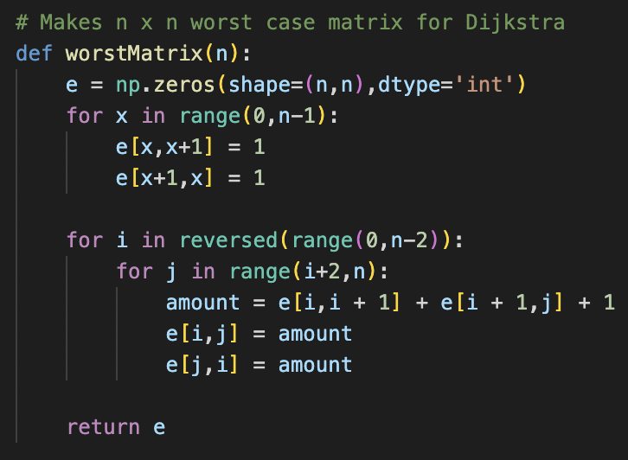
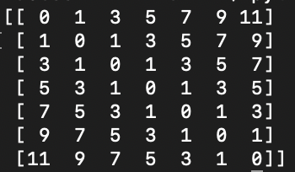
(c) Comparing the two implementations
0 1 2 3 5 7 9
0 i i i i i i
0 1 3 5 7 9 11
0 1 2 4 6 8 10
Goel Armaan
Notes:
Pass value and reference

Slide 17
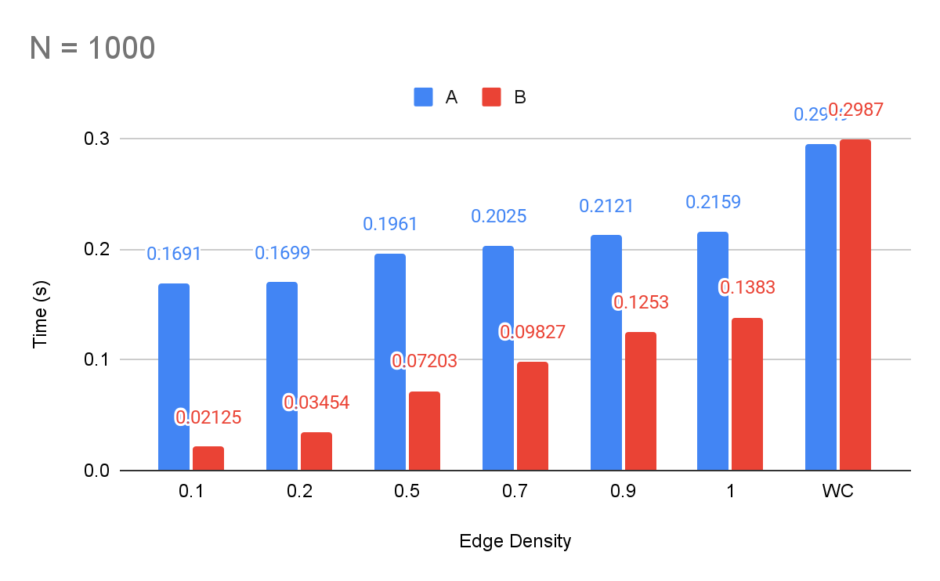
(c) Comparing the two implementations
Goel Armaan

Slide 18
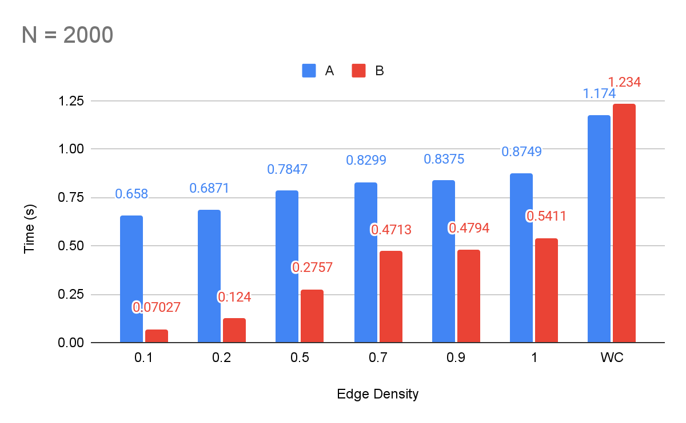
(c) Comparing the two implementations
Goel Armaan

Slide 19
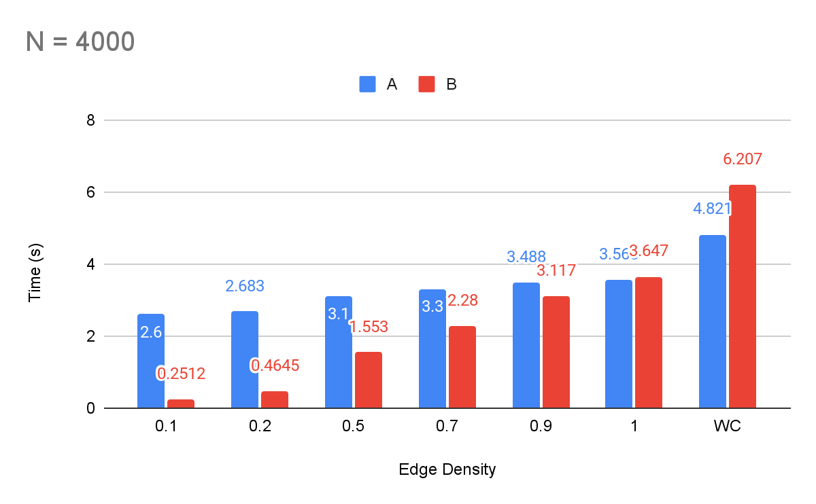
(c) Comparing the two implementations
Goel Armaan

Slide 20
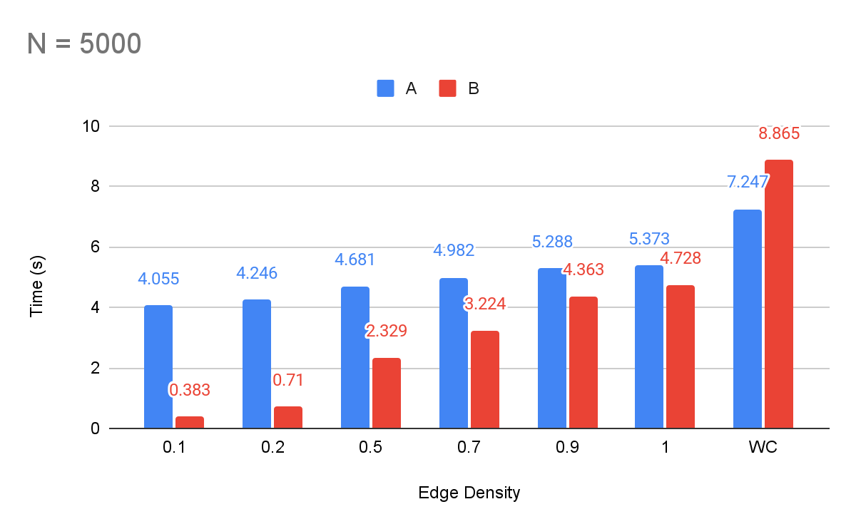
(c) Comparing the two implementations
Goel Armaan

Slide 21
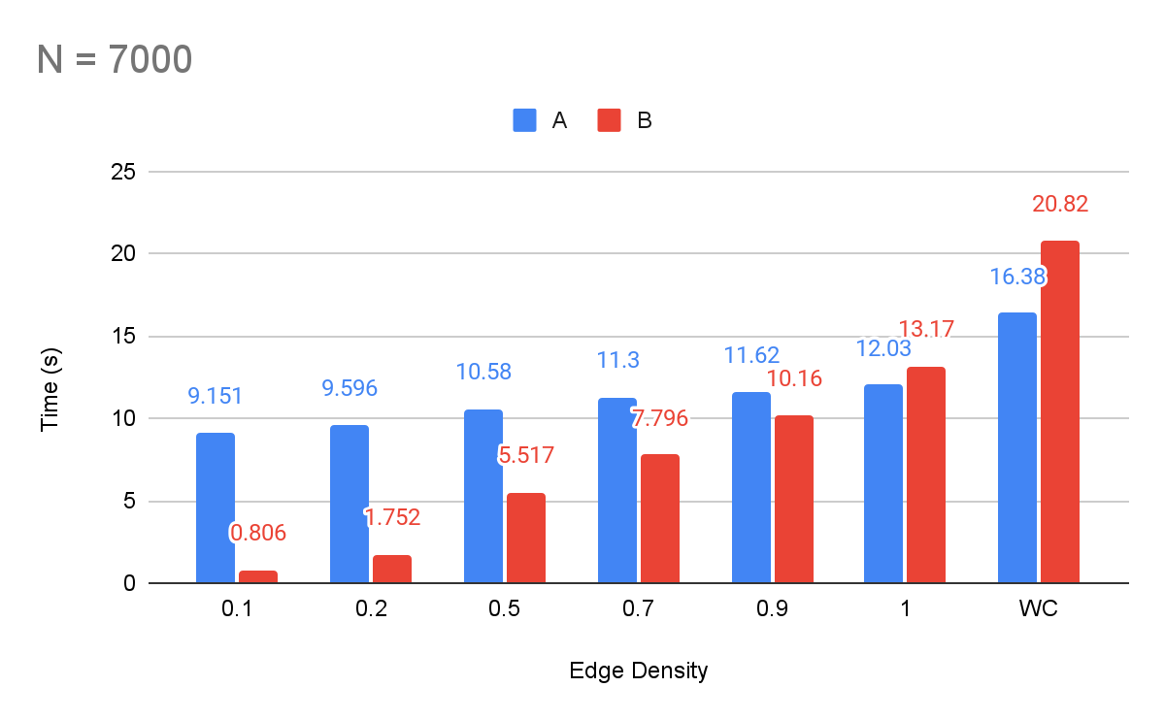
(c) Comparing the two implementations
Goel Armaan

Slide 22
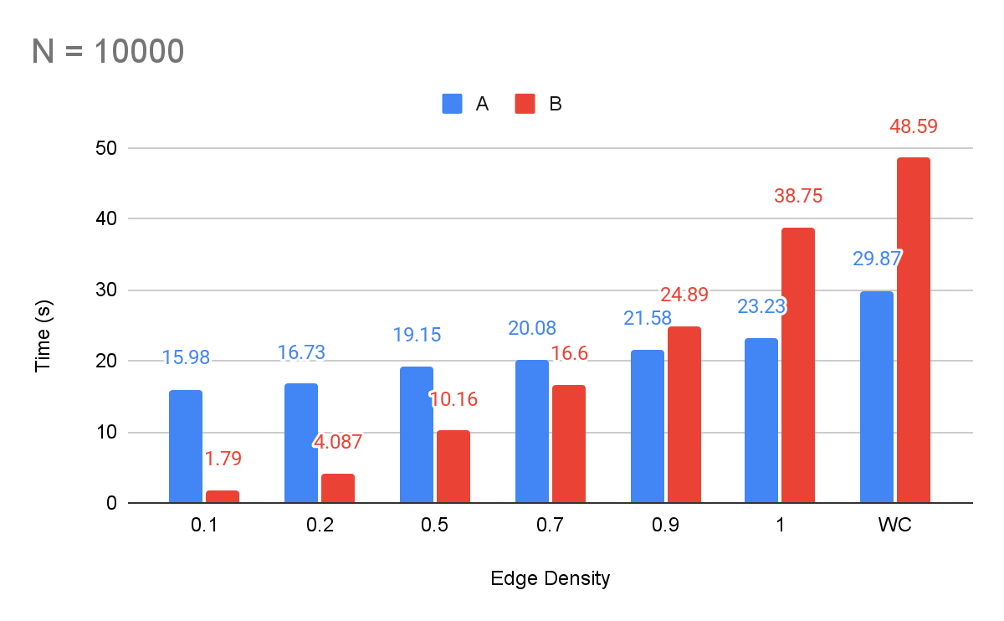
(c) Comparing the two implementations
Goel Armaan

Slide 23
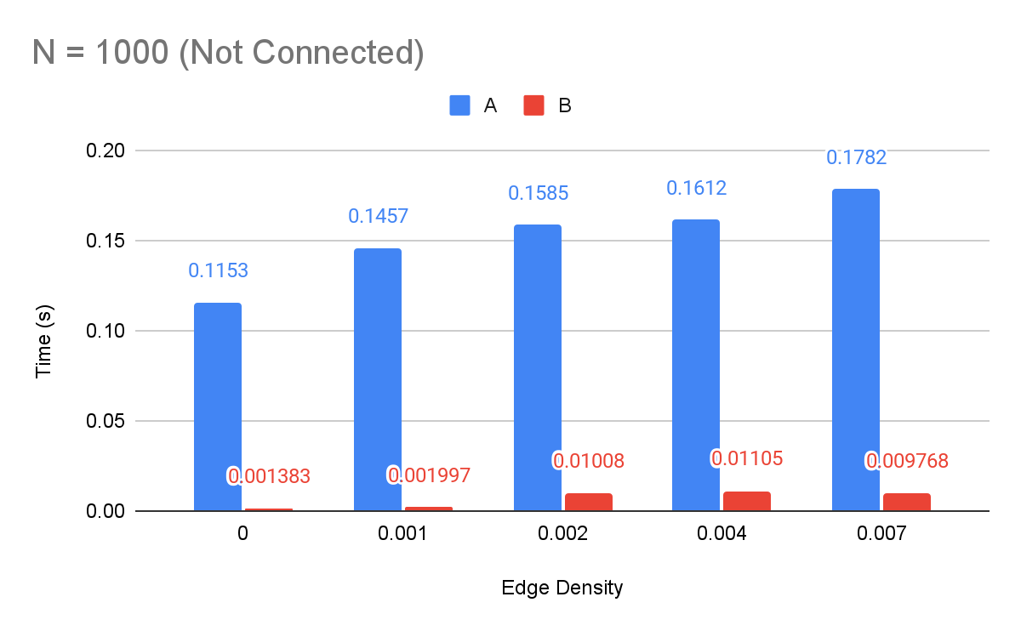
(c) Comparing the two implementations
Goel Armaan

Slide 24
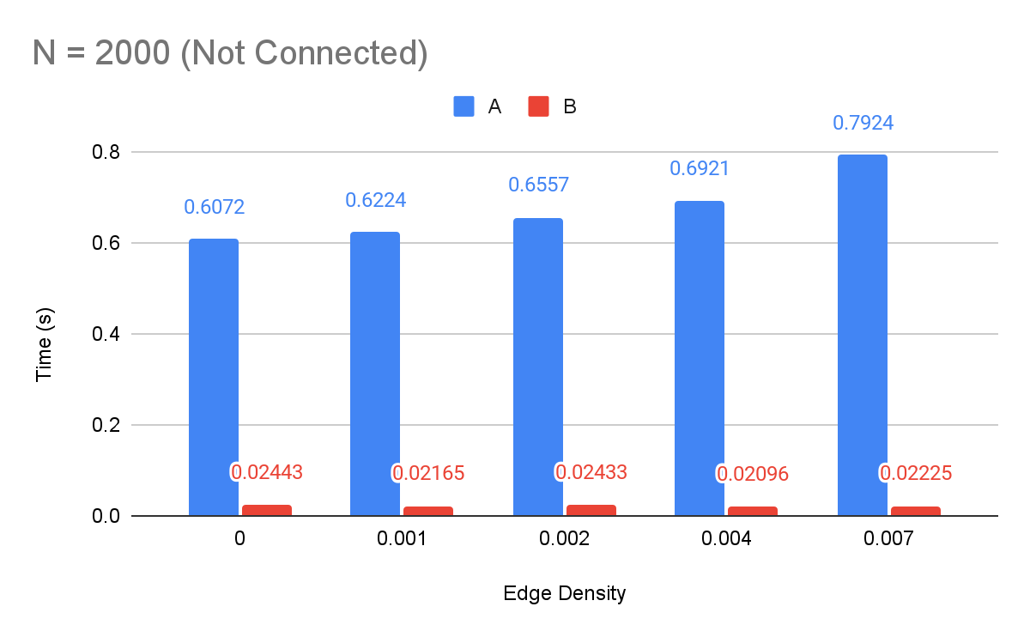
(c) Comparing the two implementations
Goel Armaan

Slide 25
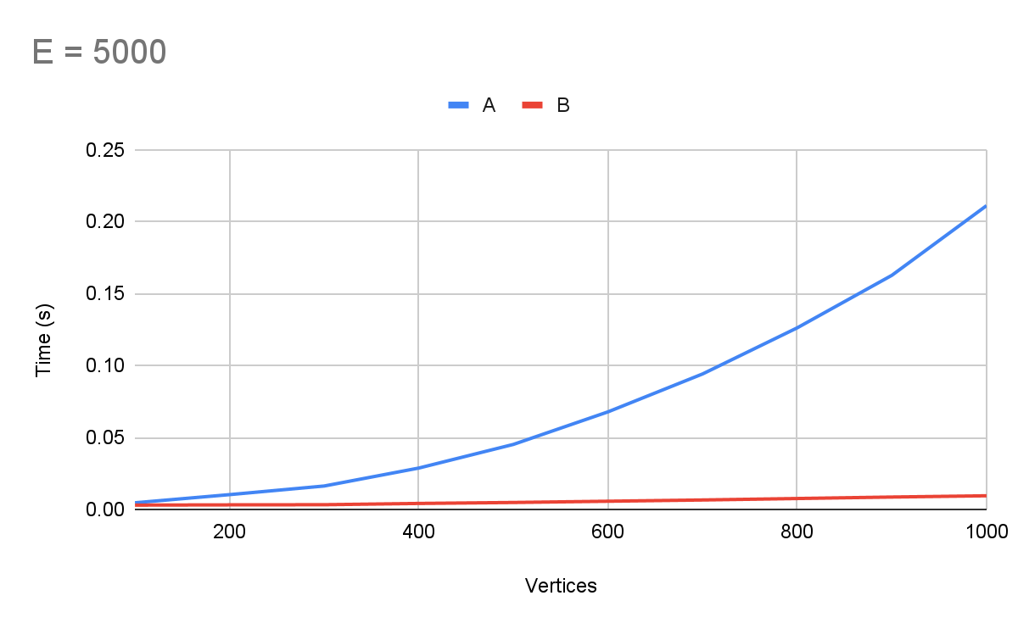
(c) Comparing the two implementations
Goel Armaan

Slide 26
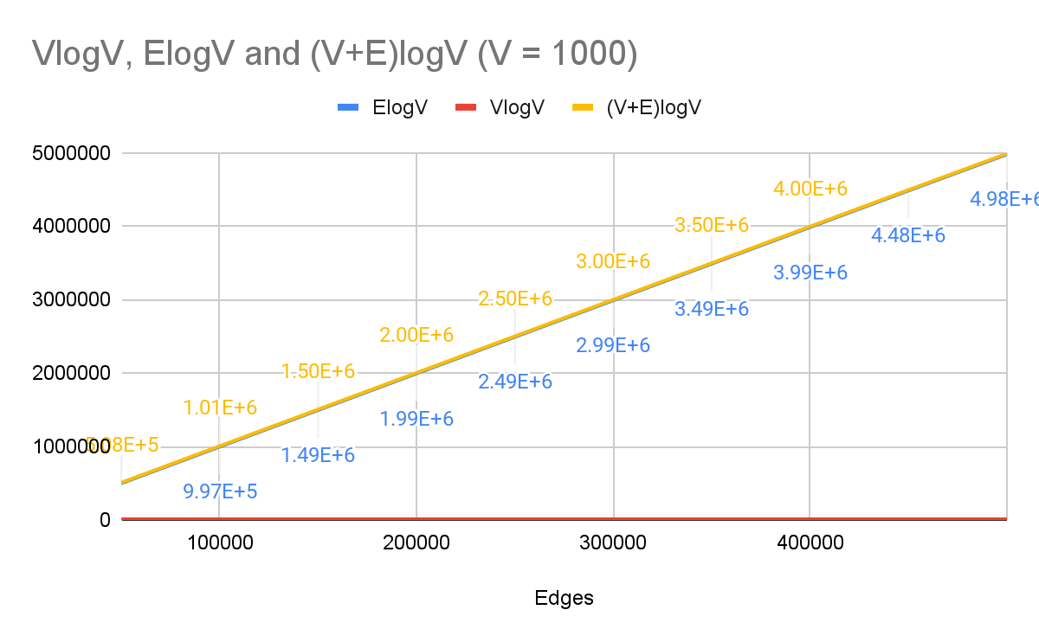
(c) Comparing the two implementations
Goel Armaan

Slide 27
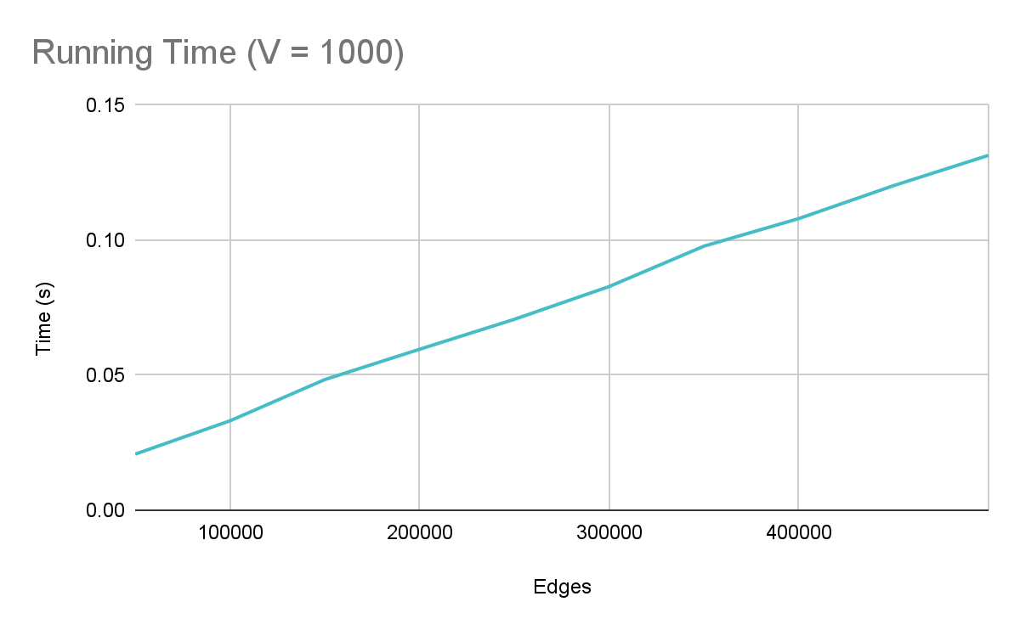
(c) Comparing the two implementations
Goel Armaan

Slide 28
Conclusion
Implementation A is mostly dependent on V and isn’t affected as much with a change in edge density.
Implementation B is highly dependant on E and runtime will increase proportionally.
B is better for low density graphs (p <= 0.5) or for smaller graphs where the number of edges is not large (V <= 2000)
A is better for high density graphs.
Goel Armaan

Slide 29
THANK YOU!

